Slide 1
CLass 1 Group 3
Q3: What is collaborative filtering? (5 minutes)
Q5: What is matrix factorization? (5 minutes)
Ryan
Tim
Johnny
Cheef

Slide 2
WHAT IS COLLABORATIVE FILTERING?
S
D
X
L
Collaborative filtering filters information by using the interactions and data collected by the system from other users. It's based on the idea that people who agreed in their evaluation of certain items are likely to agree again in the future

Slide 3
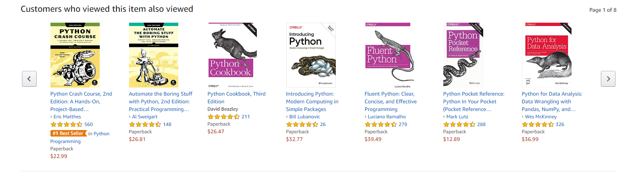
EXAMPLE
S
D
X
L

Slide 4
two classes of Collaborative Filtering:
S
D
X
L
User-based (rating prediction)
measures the similarity between target users and other users.
Item-based (item recommendation / Top N)
measures the similarity between the items that target users rate or interact with and other items.
Notes:
推荐系统来说存在两大场景即评分预测（rating prediction）与Top-N推荐（item recommendation，item ranking）

Slide 5
WHAT IS COLLABORATIVE FILTERING?
S
D
X
L
The first step is to find similar users or items.
The second step is to predict the ratings of the items that are not yet rated by a user

Slide 6
How to measure similarity:
Pearson similarity
Jaccard similarity
Spearman rank correlation
Mean squared differences
Proximity–impact–popularity similarity

Slide 7
approaches to measure the accuracy:
Root Mean Square Error (RMSE).
Mean Absolute Error (MAE): average absolute difference between predicted ratings and actual ratings

Slide 8
Disadvantage :
S
D
X
L
Cold start : we must have enough data in the system to find match
Sparsity : most of the user do not rate most of items and hence the user-item rating matrix is “sparse”,therefore the probability of finding a set of users with significant similar rating is usually low.
First rater : can not recommend an item that has not been previously rated.

Slide 9
What is matrix factorization?
Matrix Factorization is a class of collaborative filtering algorithms used in recommendation system.
Matrix Factorization algorithm work by decomposing user-item interactive matrix into the product of two lower dimensional rectangle matrix.

Slide 10
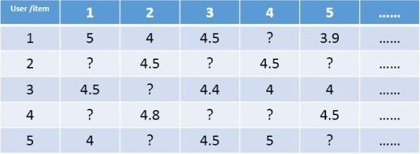
Matrix Factorization
S
D
X
L
Notes:
对于评分预测任务来说，我们通常将用户和项目（以电影为例）表示为二维矩阵的形式，其中矩阵中的某个元素表示对应用户对于相应项目的评分，1-5分表示喜欢的程度逐渐增加，？表示没有过评分记录。推荐系统评分预测任务可看做是一个矩阵补全（Matrix Completion）的任务，即基于矩阵中已有的数据（observed data）来填补矩阵中没有产生过记录的元素（unobserved data）。值得注意的是，这个矩阵是非常稀疏的（Sparse），稀疏度一般能达到90%以上，因此如何根据极少的观测数据来较准确的预测未观测数据一直以来都是推荐系统领域对于评分预测任务来说，我们通常将用户和项目（以电影为例）表示为二维矩阵的形式，其中矩阵中的某个元素表示对应用户对于相应项目的评分，1-5分表示喜欢的程度逐渐增加，？表示没有过评分记录。推荐系统评分预测任务可看做是一个矩阵补全（Matrix Completion）的任务，即基于矩阵中已有的数据（observed data）来填补矩阵中没有产生过记录的元素（unobserved data）。值得注意的是，这个矩阵是非常稀疏的（Sparse），稀疏度一般能达到90%以上，因此如何根据极少的观测数据来较准确的预测未观测数据一直以来都是推荐系统领域的关键问题。
其中，推荐系统的评分预测场景可看做是一个矩阵补全的游戏，矩阵补全是推荐系统的任务，矩阵分解是其达到目的的手段。

Slide 11
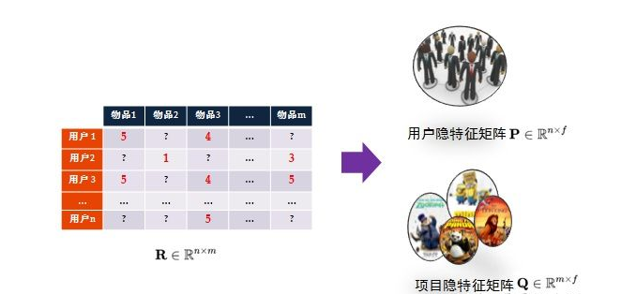
Matrix Factorization
因此，矩阵分解是为了更好的完成矩阵补全任务（欲其补全，先其分解之）。之所以可以利用矩阵分解来完成矩阵补全的操作，那是因为基于这样的假设：假设UI矩阵是低秩的，即在大千世界中，总会存在相似的人或物，即物以类聚，人以群分，然后我们可以利用两个小矩阵相乘来还原它。

Slide 12
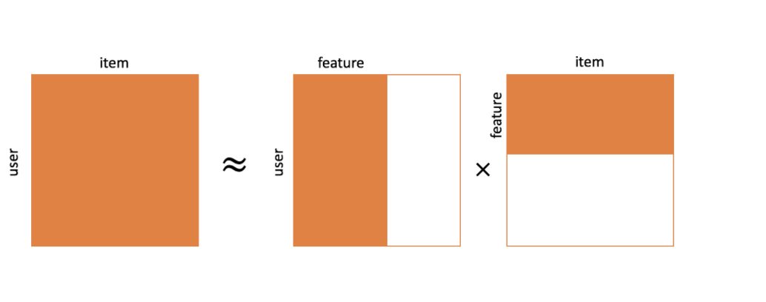
Matrix Factorization
Decompose Rating Matrix R (M* N) into P(M*K) and Q(N*K)
M is number of user
N is number of movies.
K is total latent features.

Slide 13
Matrix Factorization
Properties:
Rij contains the rating for user i of object j
Most of the value of R is missing (90% )
R is a Lower Rank matrix, for example, movie (column) Nj and Nk might look similar.

Slide 14
Common MF Method
Singular Value Decomposition (SVD)
FunkSVD
Derivation: https://docs.google.com/document/d/1ij8rl6EgfgvsEh2UCl0iQu6AAtNV4N0DvsTZ0gySTIo/edit
Probabilistic Matrix Factorization (PMF)
Derivation: https://docs.google.com/document/d/1ij8rl6EgfgvsEh2UCl0iQu6AAtNV4N0DvsTZ0gySTIo/edit
Non-negative Matrix Factorization (NMF)

Slide 15
reference:
https://zhuanlan.zhihu.com/p/35262187
https://realpython.com/build-recommendation-engine-collaborative-filtering/#:~:text=Collaborative%20filtering%20is%20a%20technique,similar%20to%20a%20particular%20user

